Slide 1
Techniques involved in tissue engineering
Mr. Viru Shah
Tuesday, August 3rd , 2010

Slide 2
Preferred book

Slide 3
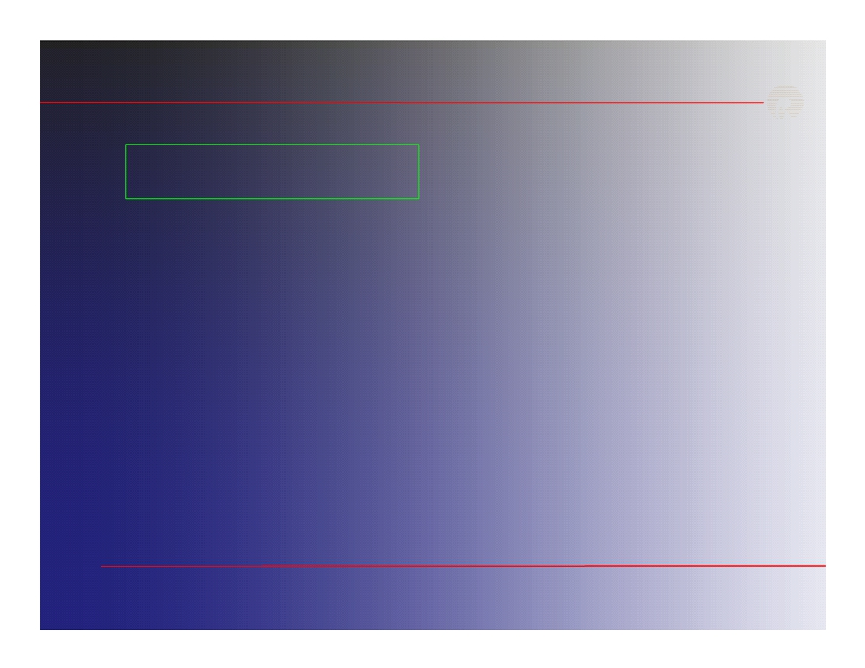
Content
Mammalian cell culture Cell identification Cell quantification Histology
Immunohistology Microscopy & SEM
2

Slide 4
Mammalian cell culture
Important components in Cell culture Lab
CO₂ incubator
Freezer (20-80 ºC)
Phase-contrast Microscopy
Laminar Air Flow (BSL 2-3, depending on the sample)
Cryotank
3

Slide 5
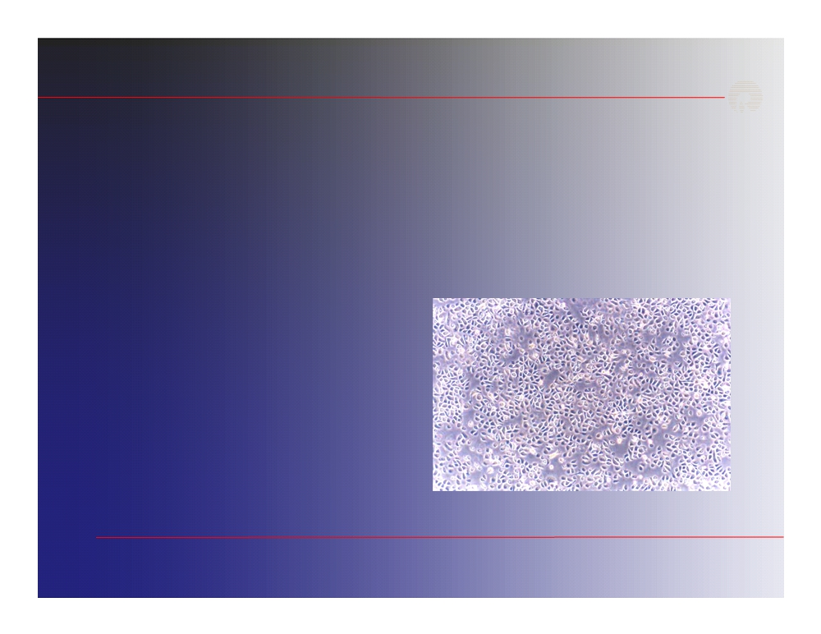
Mammalian cell culture
 Types of cells grown in culture  Work area and equipment  Cell Preservation and storage  Cell Maintenance
 Safety considerations  Tissue culture methods
Asepsis is the base of any cell culture
5

Slide 6
Mammalian cell culture
6

Slide 7
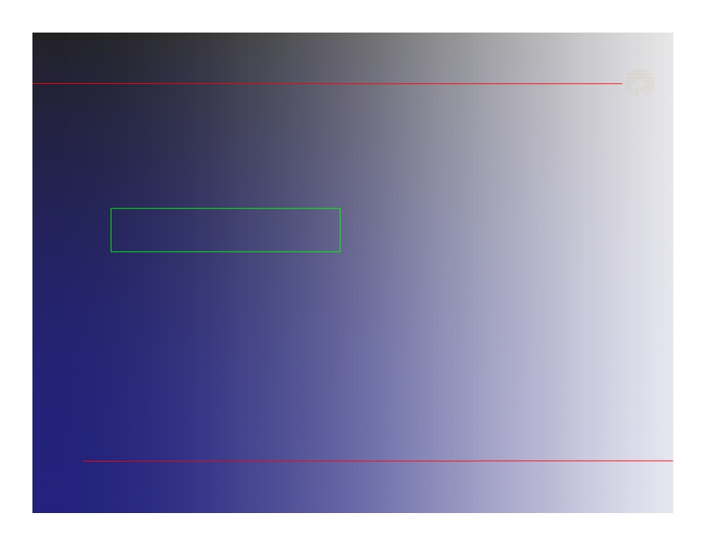
Content
Mammalian cell culture Cell identification Cell quantification Histology
Immunohistology Microscopy & SEM
7

Slide 8
Cell identification
Gross Morphological
Molecular : RT- PCR
OPN 146
PPARγ2 372
(Osteopontin)
(Peroxisome proliferator activated receptor)
Cellular : IF, FACS, Lentivirus
IF: Immunofluorescence
FACS: fluorescence activated cell sorter
8

Slide 9
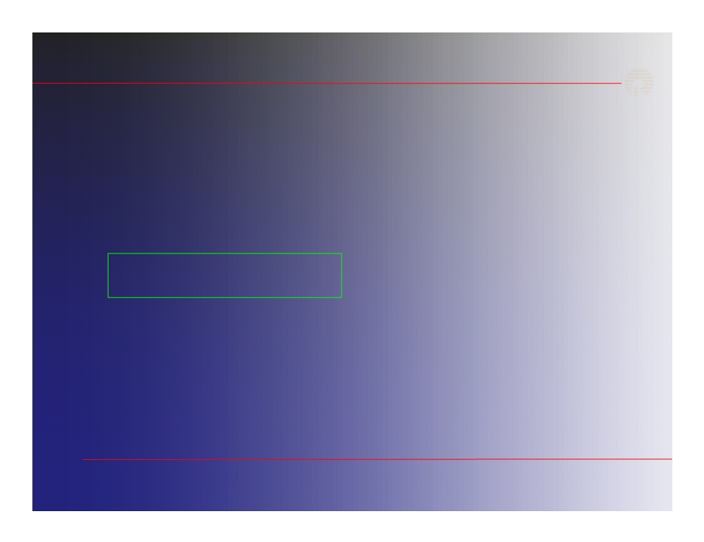
Content
Mammalian cell culture Cell identification Cell quantification Histology
Immunohistology Microscopy & SEM
9

Slide 10
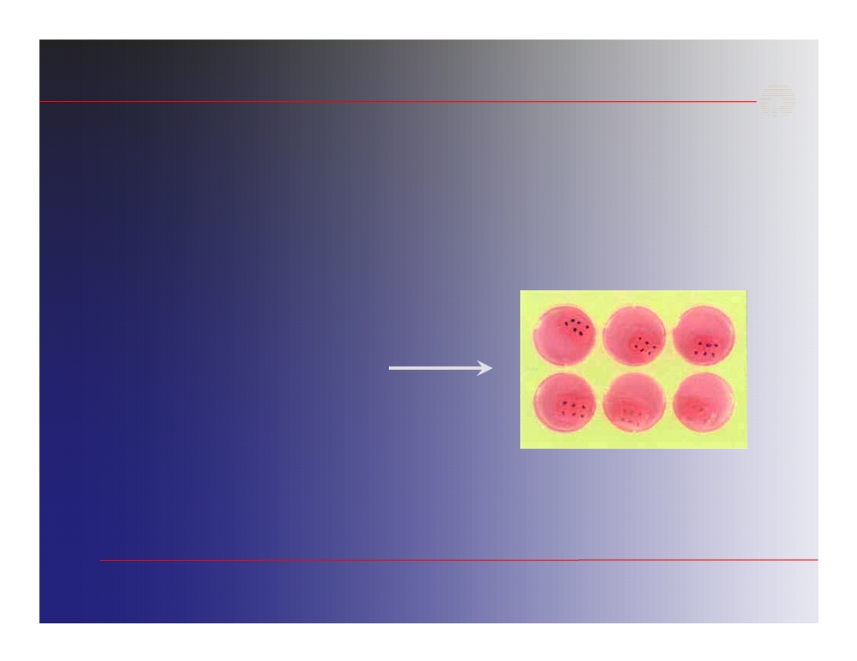
Cell quantification
The yellow tetrazolium MTT
(3-(4,
5-dimethylthiazolyl-2)-2,
5-
diphenyltetrazolium bromide) is reduced by metabolically active cells, to an insoluble purple formazan crystals. This is solubilized and quantified by spectrophotometer
Formazan crystal
Absorbance of the converted dye is measured at a wavelength of 570nm with background subtraction at 650nm.
10

Slide 11
Cell quantification
Determination of cell numbers using a hemocytometer. Cells are counted after staining with Trypan Blue. Dead cells stain, living cells do not.
Hemocytometer
Calculation: Average cell count per quadrant x dilution factor x 104 = Cells/ml
11

Slide 12
Content
Mammalian cell culture Cell identification Cell quantification Histology
Immunohistology Microscopy & SEM
12

Slide 13
Histology
Histology is the study of tissue structure . To examine the tissue components.
• Fixation
• Sectioning
• Visualization
13

Slide 14
Histology
Fixation :
Prevents its decomposition; cell metabolism is stopped. It is usually, but not always, done before sectioning
The most common fixative is Formalin, a 37% aqueous solution of formaldehyde, which is either used on its own or in combination with other chemicals
Formaldehyde reacts with the amino groups of proteins, and thus preserves the general structure of the cell and extracellular components
14

Slide 15
Histology
Sectioning :
To allow a specimen to be examined, it must be thinly sliced on the level of micrometers (1/1000th of a millimeter).
Sectioning requires a microtome. The tissue is fixed, dehydrated and completely permeated with paraffin. It is then embedded in a paraffin block. This block is stuck to a chuck, and then placed in a holder, which is progressed by a rotating wheel.
15

Slide 16
Histology
Visualization :
When observing a freshly fixed section of tissue through a microscope, very little contrast is observed between adjacent regions of tissue which may have vastly different composition and function. As a result, individual cells or parts of cells are difficult or impossible to visualize.
16

Slide 17
Mammalian cell culture Cell identification Cell quantification Histology
Immunohistology Microscopy & SEM
17

Slide 18
Immunocytochemistry
Immunocytochemistry is technique to detect localized protein or molecule by using antibodies
Immunocytochemistry
Screening for antibody reactivity
New investigations
Diagnosis and treatment
Immunohistology = Immunochemistry of proteins in situ
Immunohistochemistry = tissues
= cells in their normal environment
Immunocytochemistry = cells
= cells isolated from tissues, cells in culture
18

Slide 19
Immunocytochemistry
Peroxidase method:
In this method the enzyme most often coupled to the anti-IgG is peroxidase, which is reacted with 3’ , 3’ diaminobenzidine (DAB) in the presence of H2O2. This reaction gives an electron-dense deposit that can be detected with light microscope.
19

Slide 20
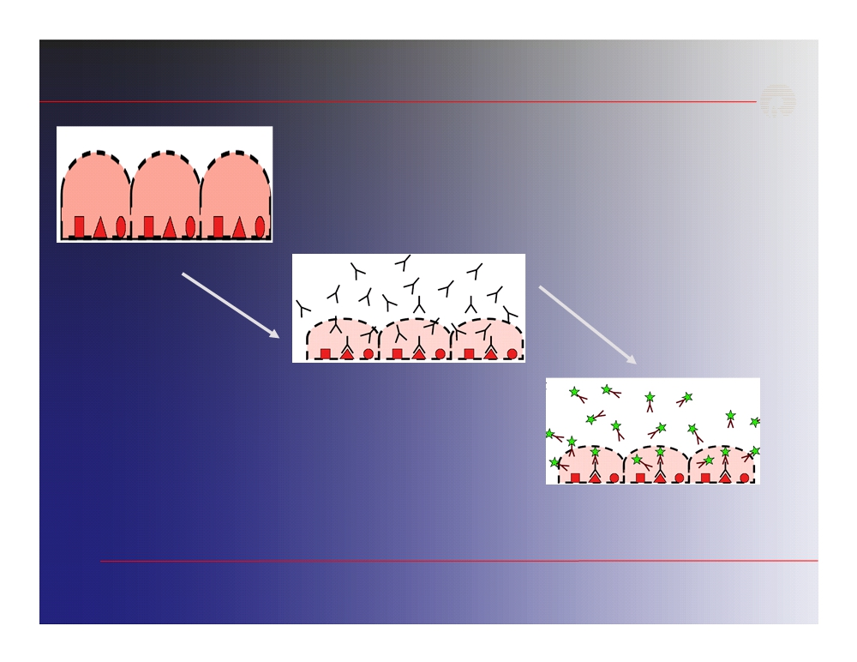
Immunocytochemistry
Fix cell & Permeabilize
Expose to primary antibodies
Secondary antibodies carrying tag
20

Slide 21
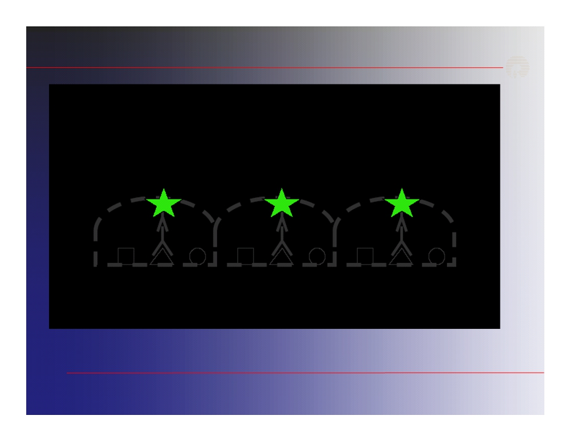
Immunocytochemistry
UV illumination - immunofluorescence
21

Slide 22
Immunocytochemistry
22

Slide 23
Immunocytochemistry
Immunocytology vs immunohistology
Cells (better resolution by cytology) versus tissues (better expression context in tissues)
Resolution of cellular component
23

Slide 24
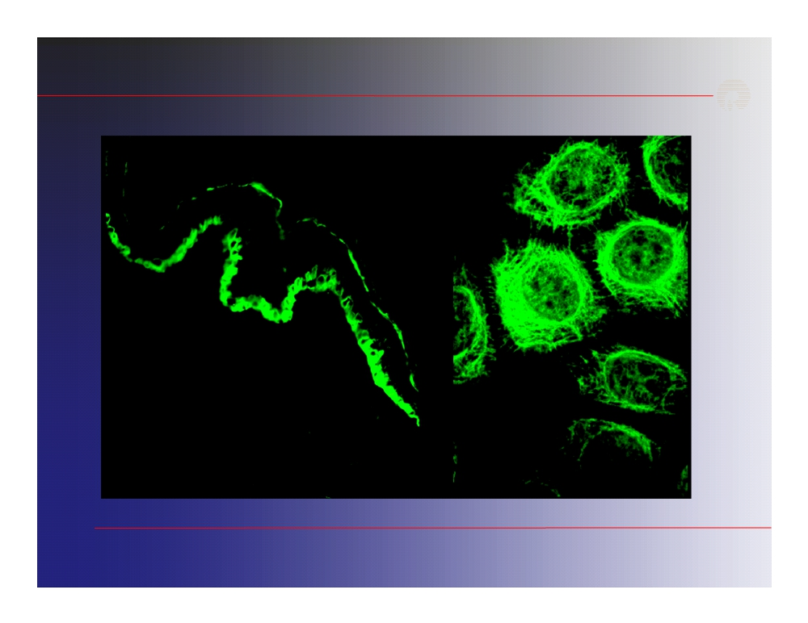
Immunocytochemistry
24

Slide 25
Immunohistology
Common problems in immunohistology
 Antibodies do not work as describes
- Use reputable sources, complain to supplier, test them yourself  Antibodies do not react with formalin-fixed section
-Try frozen section, different fixatives, antigen retrieval methods; stronger antibody? polyclonal antibody
 High background on mouse tissues
-Try blocking strategies, direct labeling
25

Slide 26
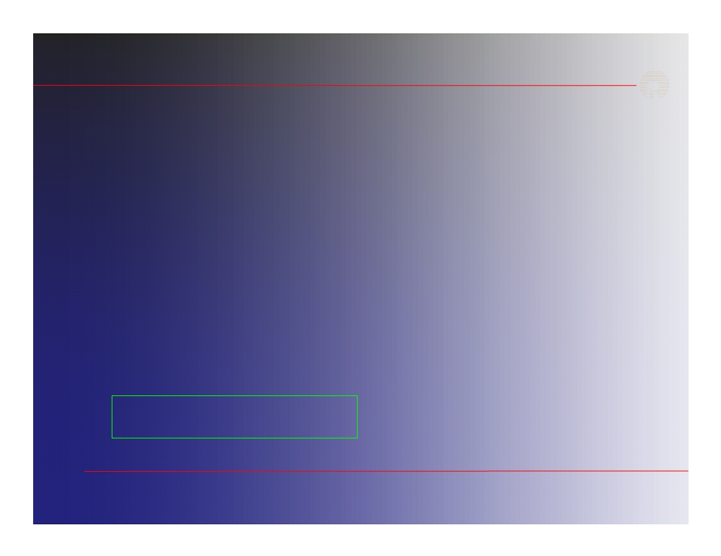
Mammalian cell culture Cell identification Cell quantification Histology
Immunohistology Microscopy & SEM
26

Slide 27
Microscopy & SEM
The observation of biological structure is made difficult by the fact that cell are in general, very small and transparent to visible light and thus are not visible to the unaided eye.
Light microscopy
Fluorescence microscopy
Scanning electron microscopy
27

Slide 28
Microscopy & SEM
In light microscopy resolving power depends upon the wave length ( λ ) and the numerical aperture ( NA ) of objective lens.
The limit of resolution, defined as the minimum distance between two points that allows for their discrimination as two separate point
Limit of resolution =
0.61 λ
NA
With white light, the resolving power is about 250 nm (0.25 µm)
The higher the resolving power ,the smaller the limit of resolution
28

Slide 29
Microscopy & SEM
Light Microscope
Bright field of human ileum
29

Slide 30
Microscopy & SEM
1. Energy is absorbed by the atom which becomes excited.
2. The electron jumps to a higher energy level.
3. Soon, the electron drops back to the ground state, emitting a photon (or a packet of light) - the atom is fluorescing.
Immunofluorescence staining of epithelium
Fluorescence microscope
cell
(Hep-2) mitochondria
30

Slide 31
Microscopy & SEM
Scanning electron microscopy (SEM) helps in studying the surface view of the specimen employing secondary electron emission that is ejected after the primary electron beam has interacted with the surface of a thick specimen
Scanning electron microscope (SEM)
Polymer Scaffold
31

Slide 32
Thank You!

